Slide 1
Advanced Node.js, TypeScript API Development Course: Building a Robust Inventory Management System with POS

Slide 2
Welcome to this advanced course where we will build a powerful API for an Inventory Management System with a Point of Sale (POS) using Node.js, TypeScript, Express, MongoDB, and Prisma.
This course is designed for developers who want to deepen their understanding of backend development using TypeScript and Node.js, and it will guide you through building a production-ready API that you can use in real-world applications.
The API we will build is intended for a client managing multiple drug shops, requiring comprehensive features like user roles, shop management, and extensive product relationships.

Slide 3
What We Will Build:
In this course, we will create an API that supports the following functionalities:
Authentication and Authorization: Implementing a robust system where the admin can log in, create shop attendants, and manage user roles and permissions.
Shop Management: Allowing the admin to create and manage multiple shops.
Product Management: Admin can create products with complex relationships, including categories, manufacturers, product families, industries, and units.
Customer and Sales Tracking: Features to track customers, sales, and orders, providing a comprehensive overview of shop performance.

Slide 4
Course Outline:
Introduction & Setup
Overview of the project
Setting up the development environment
Installing Node.js, TypeScript, and Express
Initializing a new Node.js project
Setting Up TypeScript & Express
Configuring TypeScript in a Node.js project
Setting up Express with TypeScript
Creating basic route handlers
Handling errors and middlewares
Integrating Prisma with MongoDB
Setting up Prisma in a Node.js project
Configuring MongoDB as the database
Defining the Prisma schema
Running migrations and seeding the database
Building Authentication & Authorization
Implementing JWT for authentication
Setting up roles and permissions
Creating middleware for role-based access control
Building routes for user registration, login, and role management

Slide 5
Shop Management Module
Creating the Shop model in Prisma
Building routes for shop creation and management
Associating shops with users (admin and attendants)
Implementing CRUD operations for shops
Product Management Module
Defining the Product model with relationships (category, manufacturer, etc.)
Building routes for creating and managing products
Implementing filters and search functionality for products
Managing product inventory and stock levels
Customer & Sales Tracking Module
Creating models for customers, sales, and orders
Building routes for managing customers
Implementing order processing and sales tracking
Generating reports and summaries for shop performance
Testing & Deploying the API
Writing unit and integration tests for the API
Setting up CI/CD for continuous deployment
Deploying the API to a production environment (e.g., Railway)
Monitoring and logging API performance
Future Extensions
Overview of building a React Native app to consume the API
Planning for future updates and feature enhancements

Slide 6
INVENTORY MANAGEMNT SYSTEM
API
User Management
Suppliers Management
Customer Management
Shop Management
Product Management
Point of Sale
Expenses Management
Employee Management
Roles and Permissions
Reports
Customer Credit Management
Login
Product Category
Product Family
Product Unit Mgt
Product Industry Mgt
Product Brand
Sales
Orders
Stock Alerts
Stock Purchase
Stock Adjustment

Slide 7
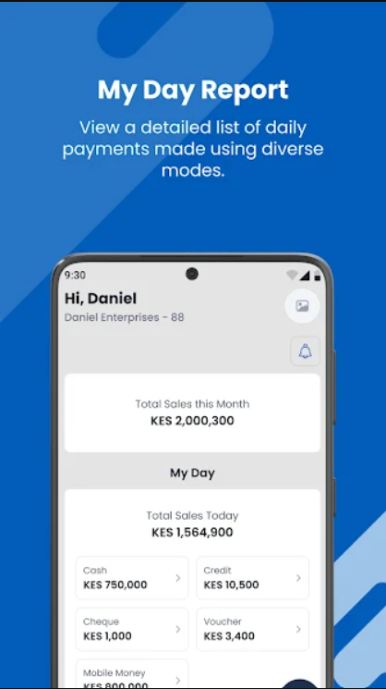

Slide 8
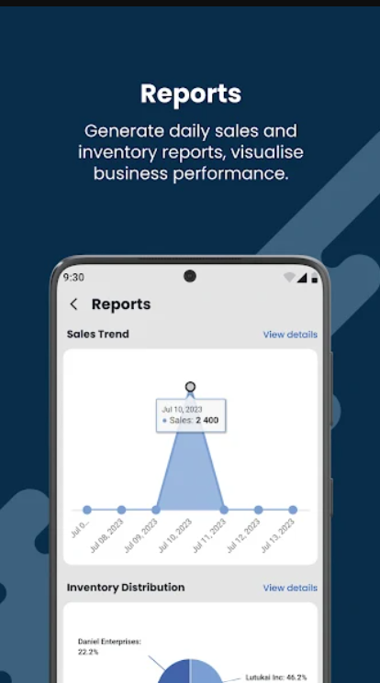

Slide 9
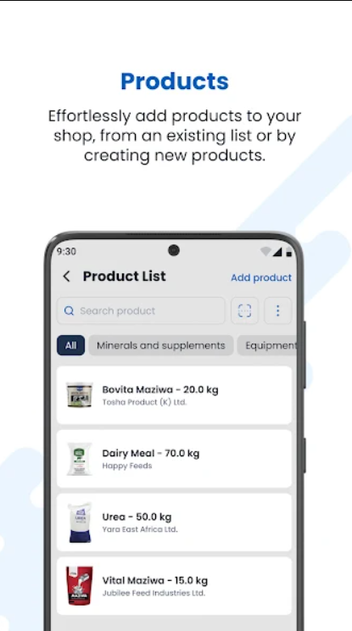

Slide 10
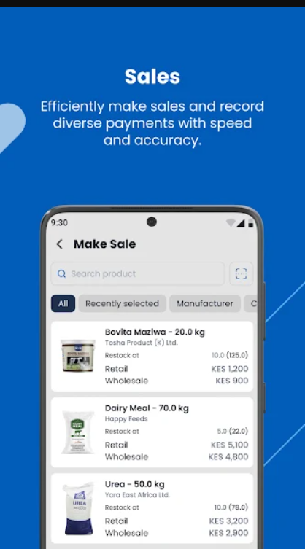

Slide 11
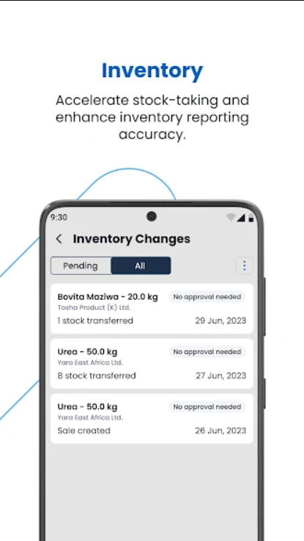

Slide 12
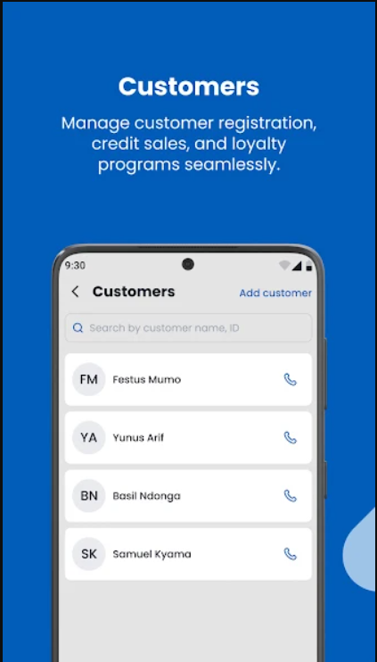

Slide 13
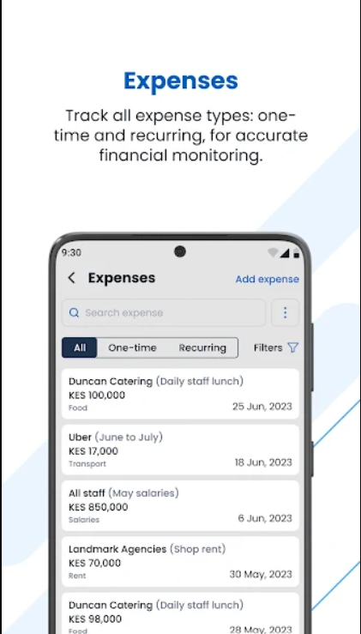

Slide 14
SHOP OWNER

Slide 15
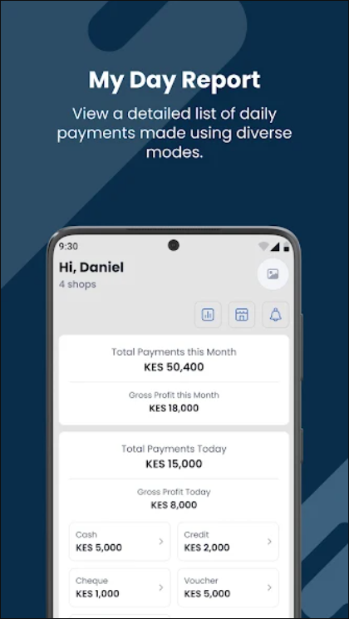

Slide 17
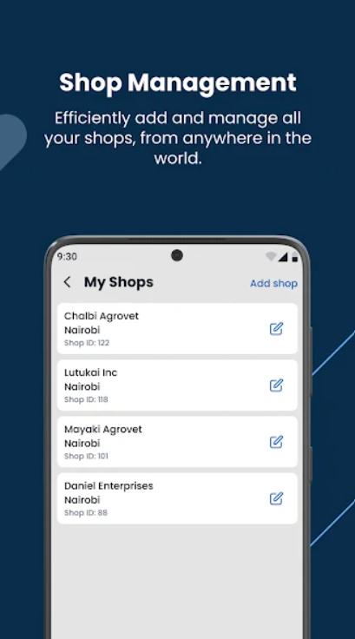

Slide 18
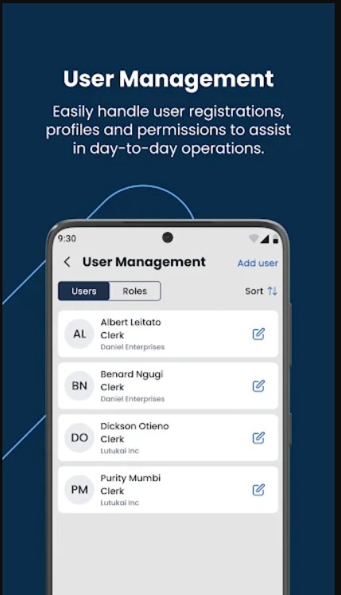

Slide 19
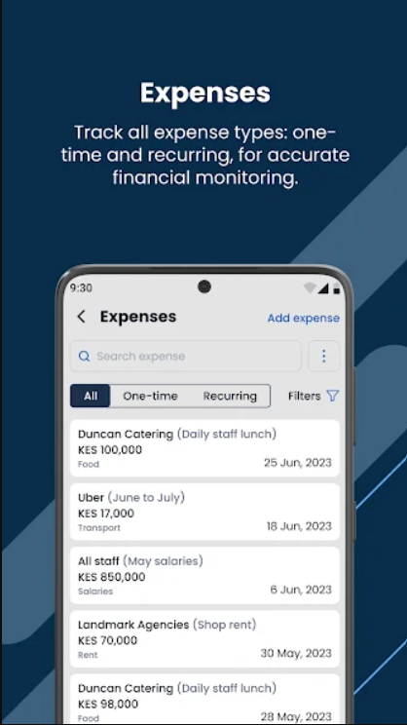

Slide 20
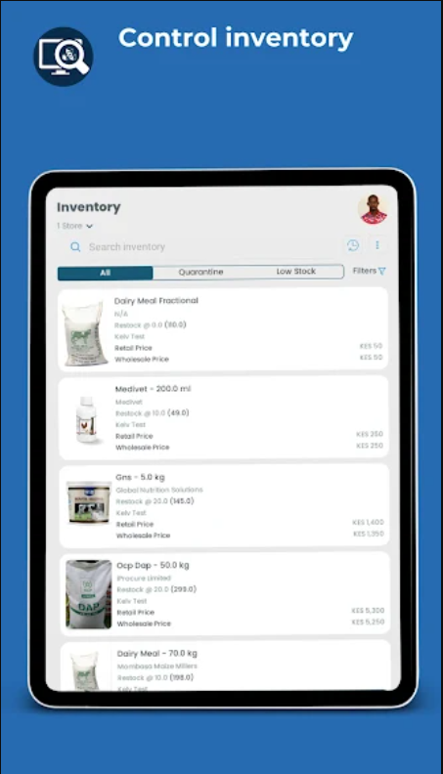

Slide 21
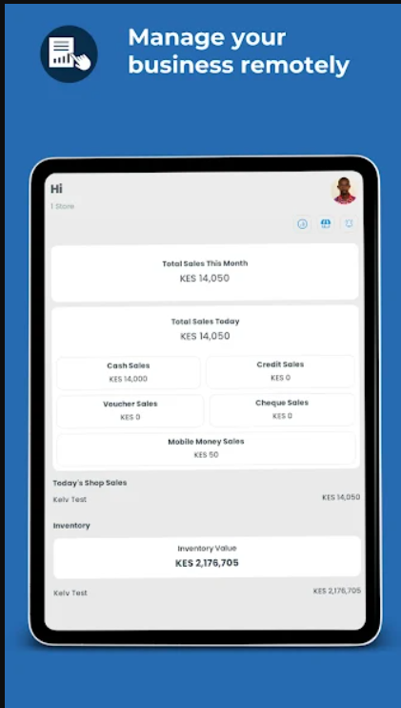

Slide 22
USER AND SHOP MANAGEMENT
Shape - Fields (Get these from a form)
Relationships (Dropdowns /Selections in forms)

Slide 23
USER AND A SHOP
One-to-Many Relationship
User as Admin:
A User can be an Admin of multiple Shops. This means that a single user, when assigned the role of ADMIN, has the ability to manage more than one shop.The relationship is represented by the admin field in the Shop model. Each shop has an adminId which is a foreign key linking it to a specific user (the admin).In Prisma, this is implemented as a one-to-many relationship, where one user (admin) can be associated with multiple shops.
User as Attendant:
A User can also be an Attendant in a shop. Attendants work in shops created by the admin.This is represented by the attendants field in the Shop model, where the shop can have multiple attendants.

Slide 24
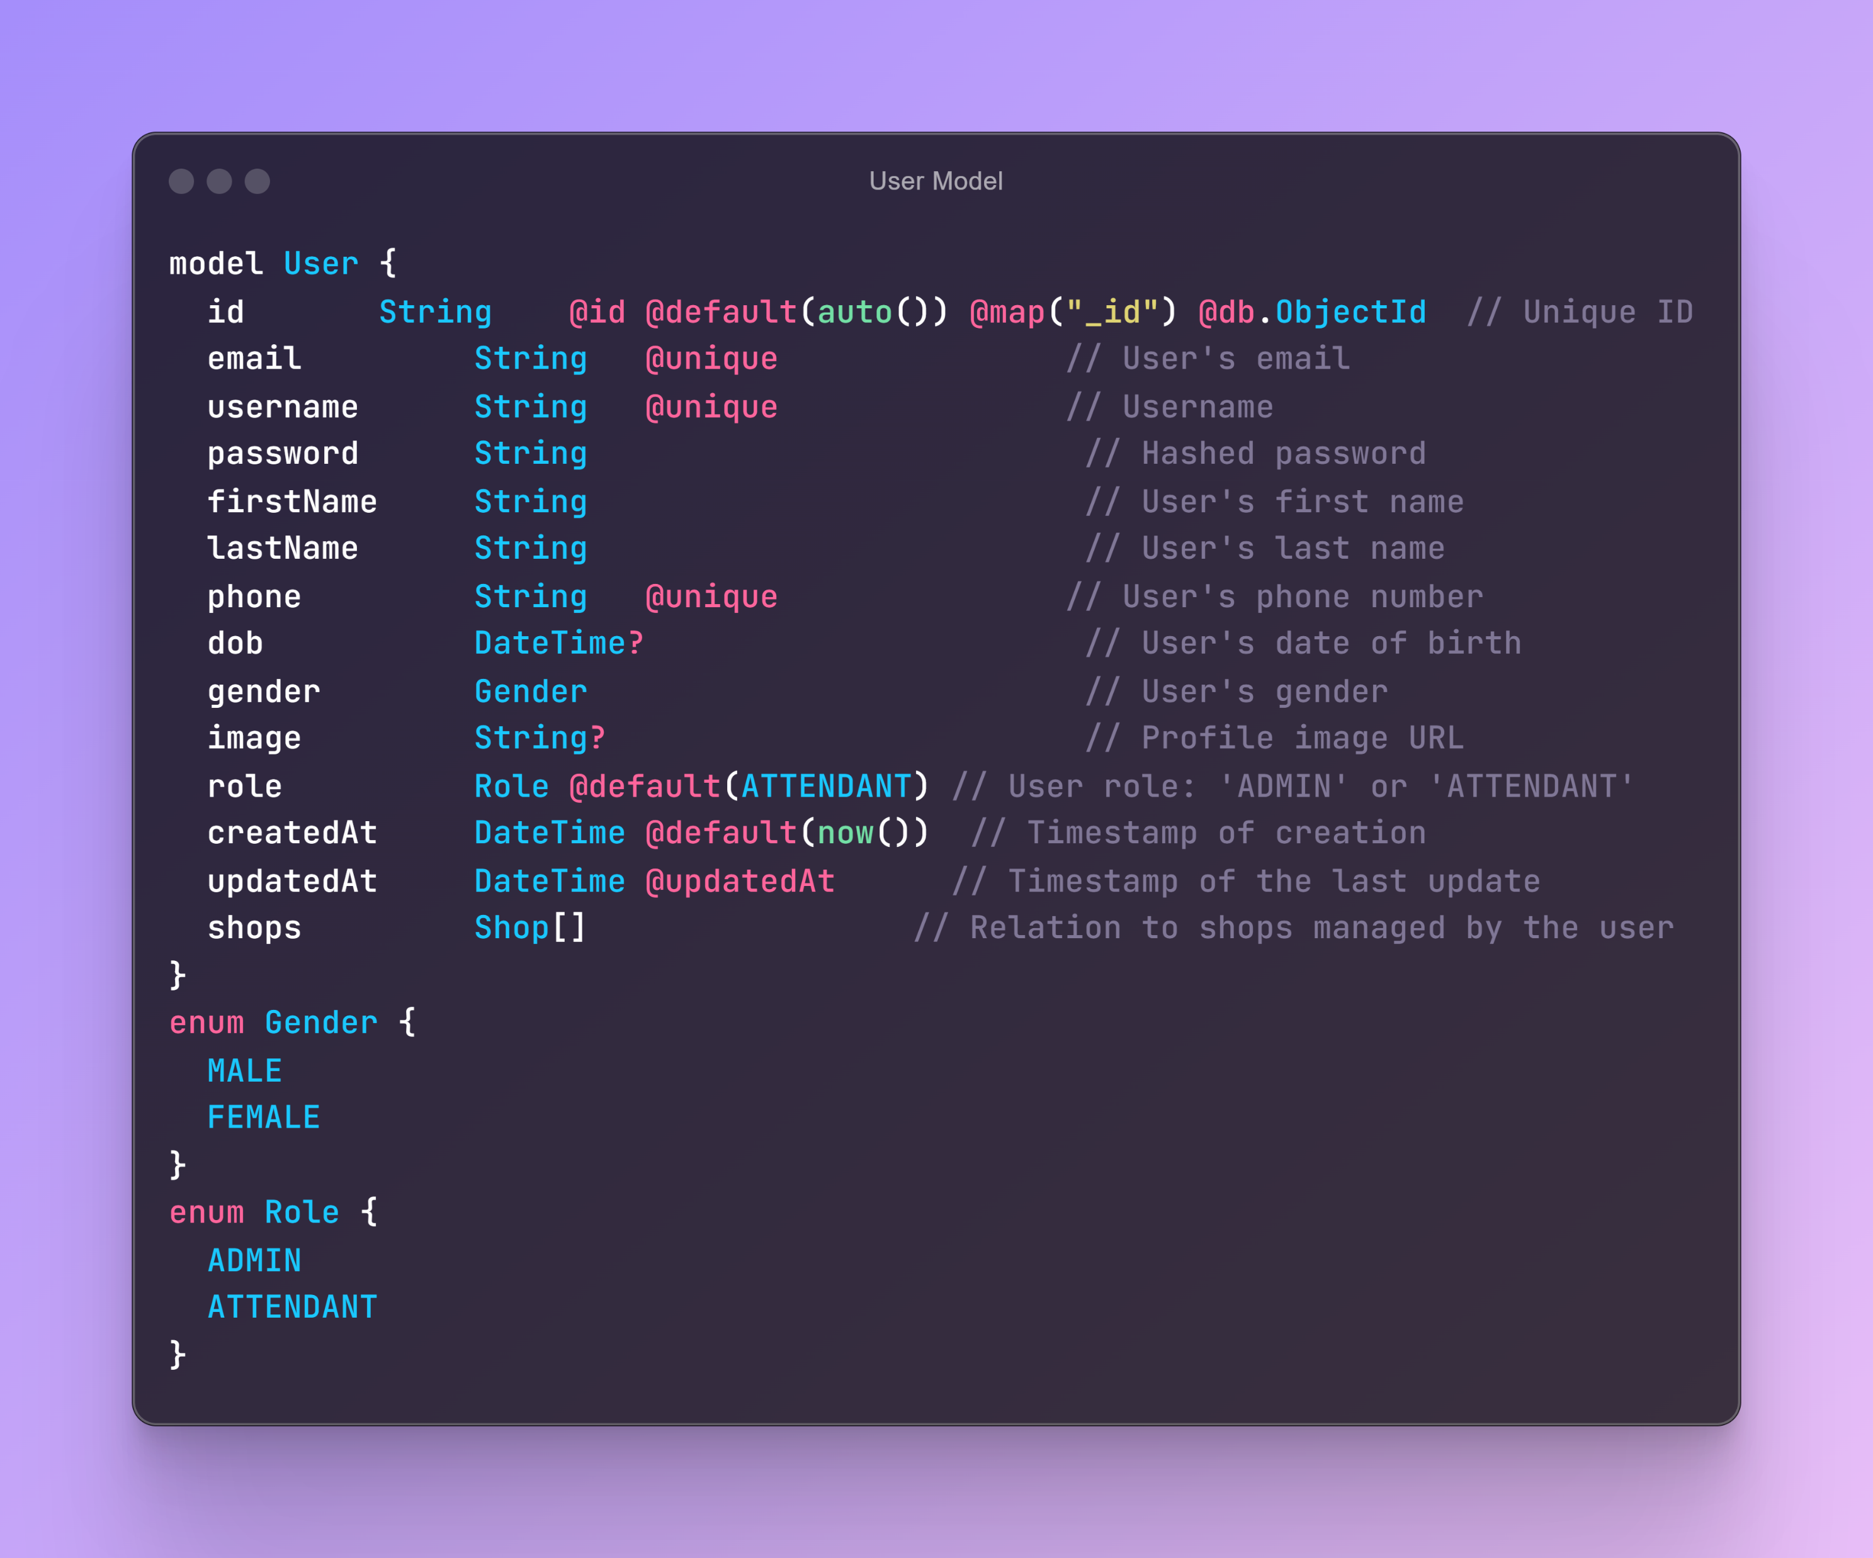
USER MODEL

Slide 25
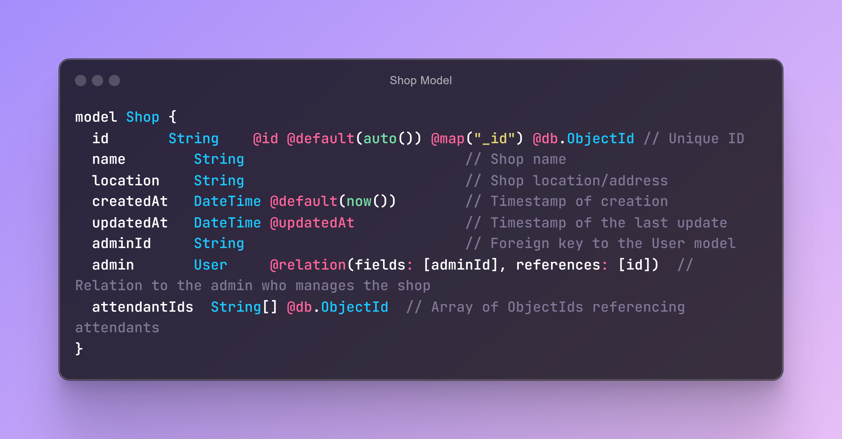
SHOP MODEL

